Slide 1
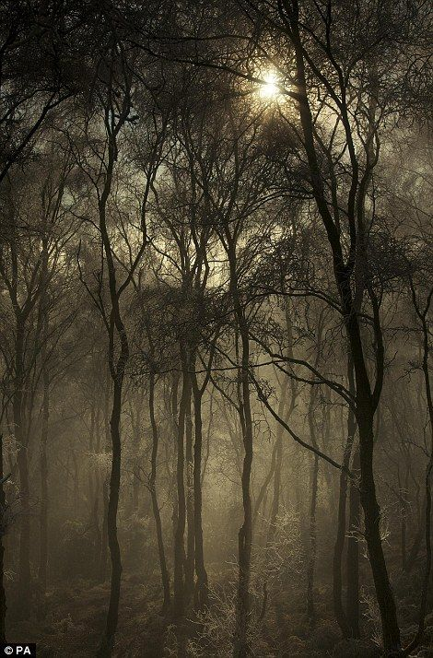
Light and Time
Evidence of Life...
Robert Fulton

Slide 2
What is it like to experience your location…?

Slide 3
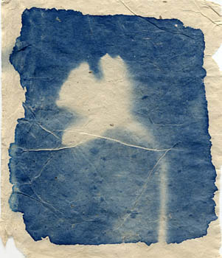
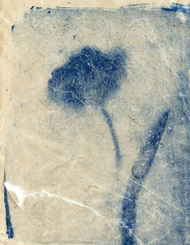
Impressions left behind
Joy Gregory

Slide 4
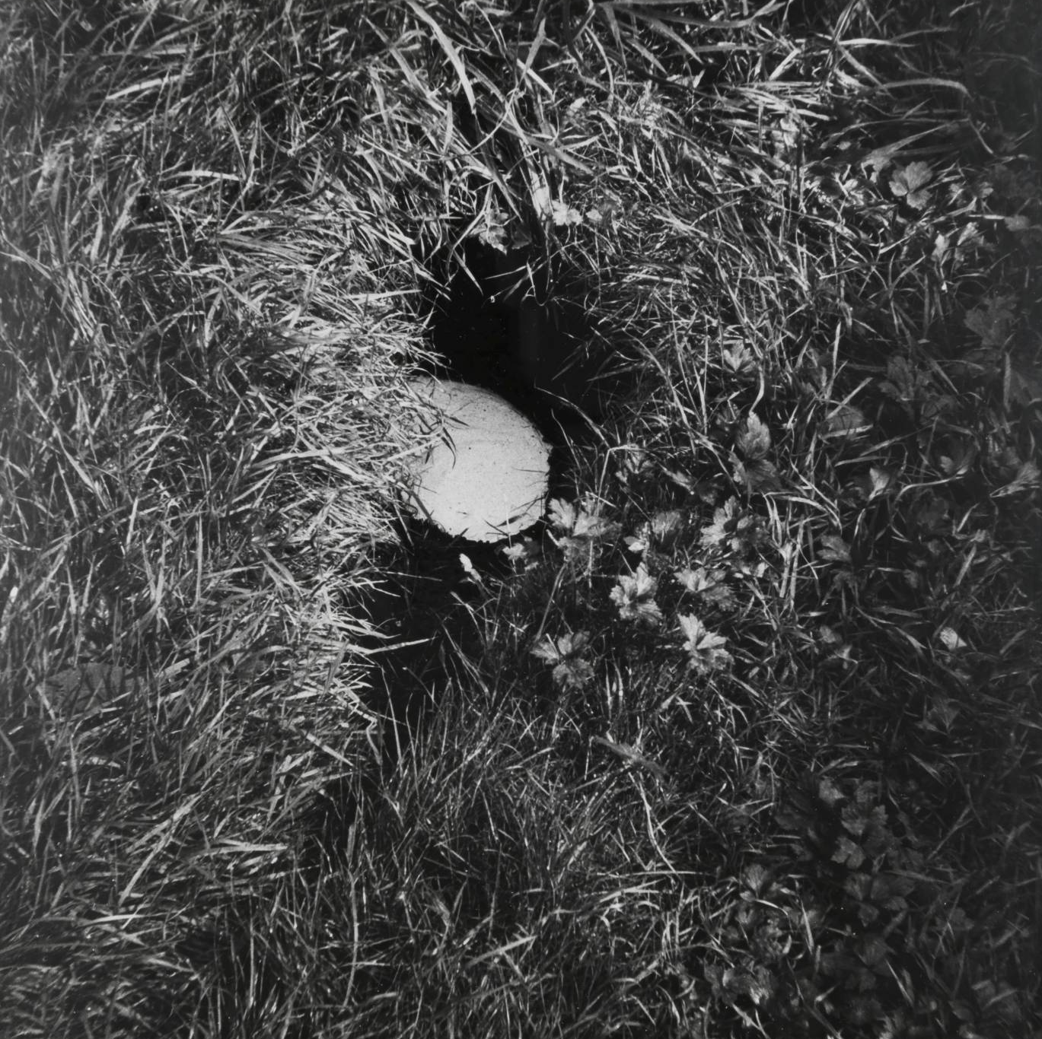
Texture and surface
Richard Long

Slide 5
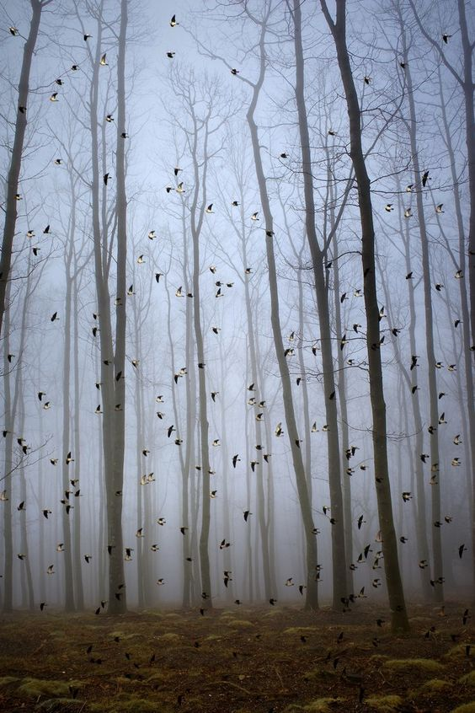
Evocative sounds

Slide 6

Human control

Slide 7
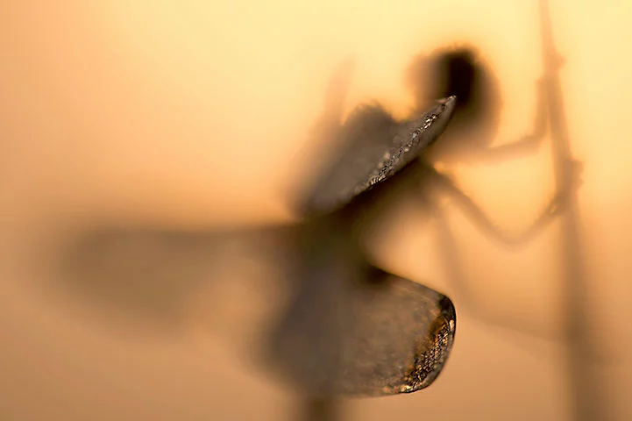
A trick of the eye
Karsten Mosebach

Slide 8
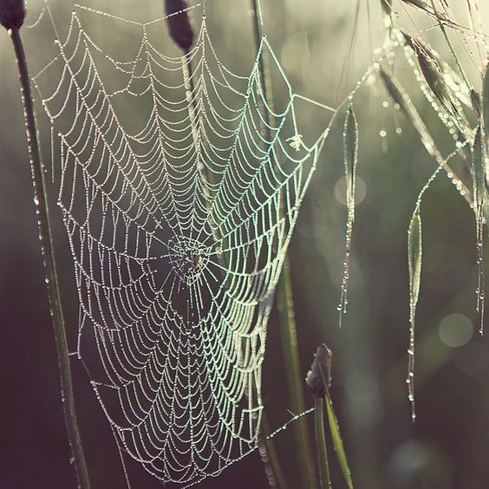
Fragile structures

Slide 9

Silence

Slide 10
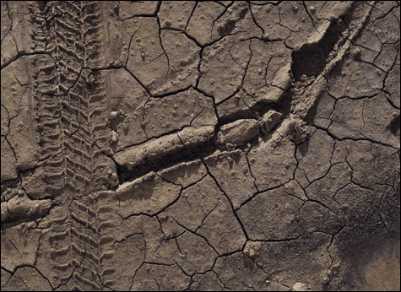
Surface clues
The Boyle Family

Slide 11

Depth of field

Slide 12
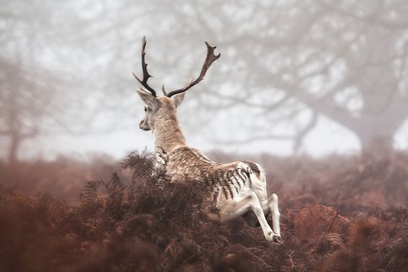
Split second reactions

Slide 13
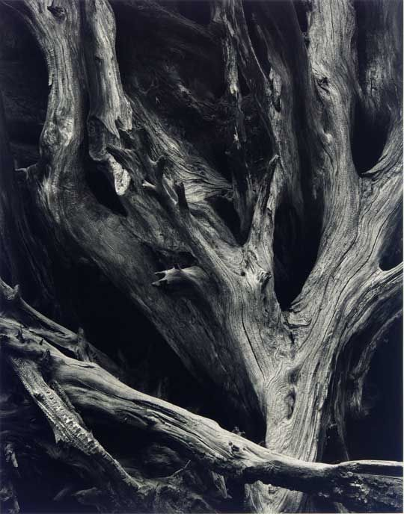
A story told through line and age
Ansel Adams

Slide 14

The ambiguous narrative

Slide 15
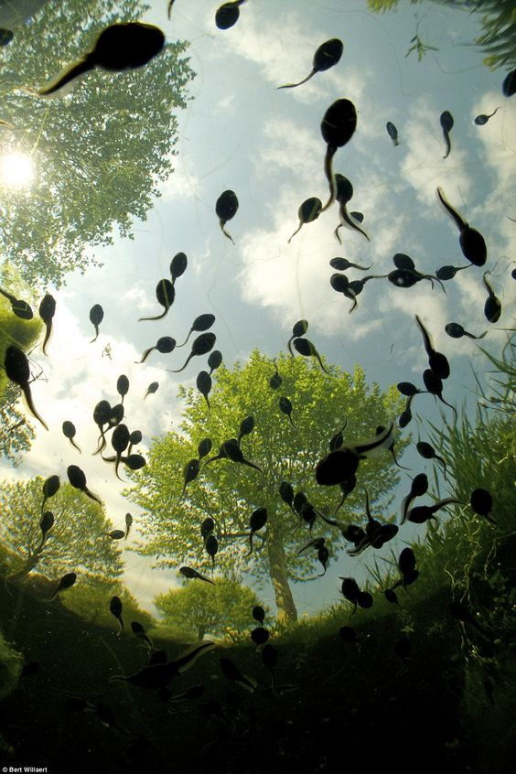
Through the eyes of nature
Bert Willaert

Slide 16
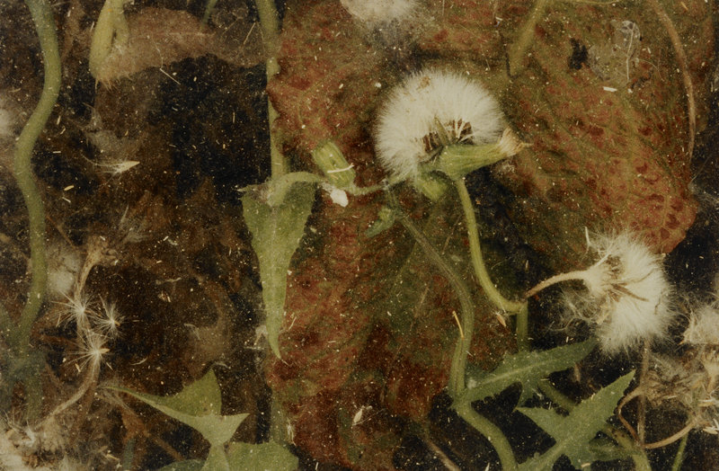
Under the surface
Fay Godwin

Slide 17
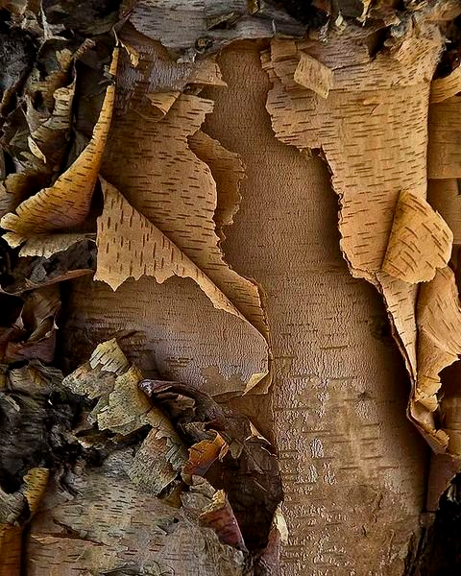
Layers of time

Slide 18

Transient tensions

Slide 19

Covert suspense
Hermann Hirsch

Slide 20

In the mind of a creature

Slide 21

Life and death
Morgan Silk

Slide 22

Becoming part of the forest

Slide 23


Life in the macro world

Slide 24
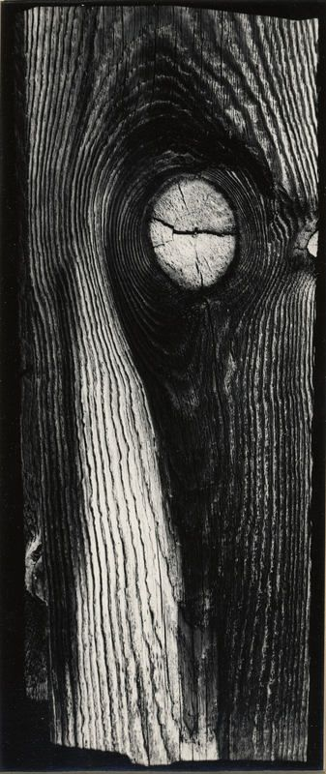
Patterns evoke imagination
Minor White

Slide 25

Warmth of the sun

Slide 26
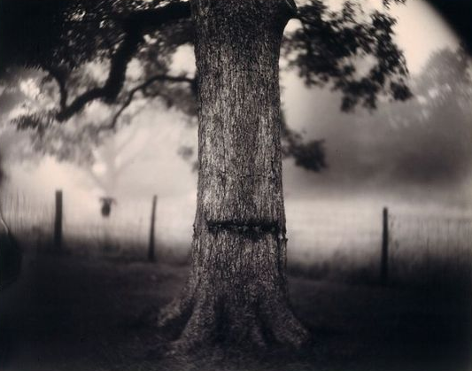
Acts of violence
Sally Mann

Slide 27

Frozen fingertips

Slide 28
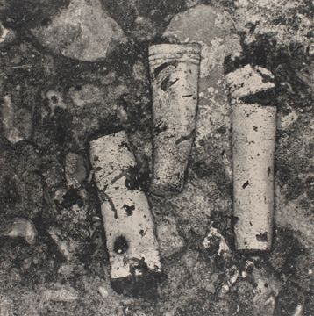
Remains of humanity
Irving Penn

Slide 29
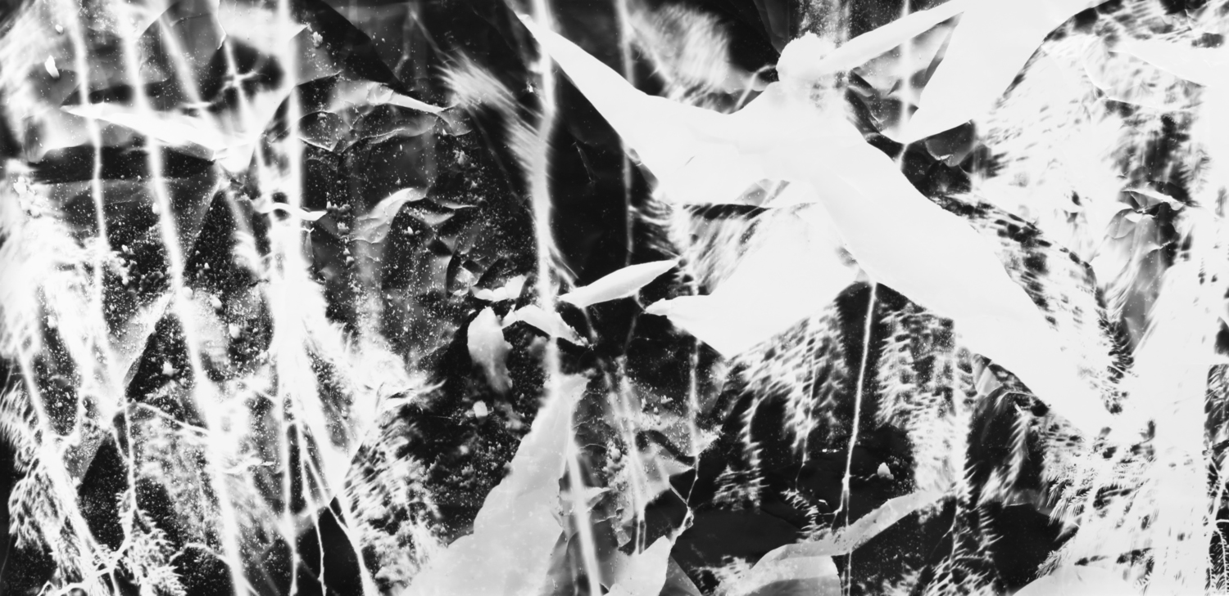
Energy
Michael Flowmen

Slide 30

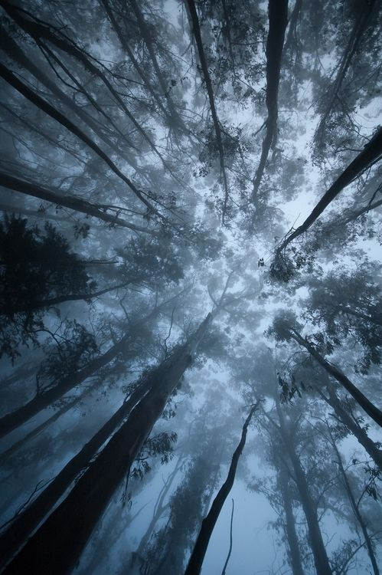
Dawn and twilight

Slide 31
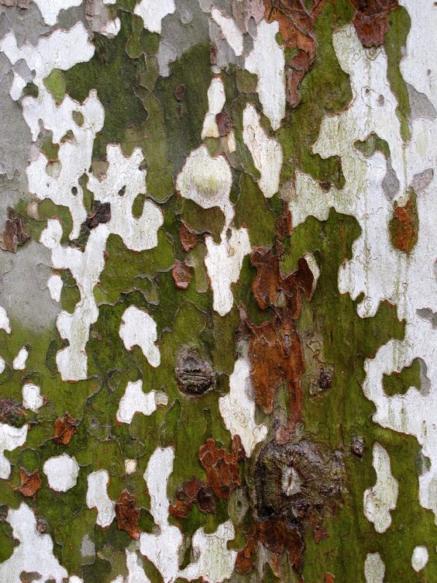
Camouflage

Slide 32
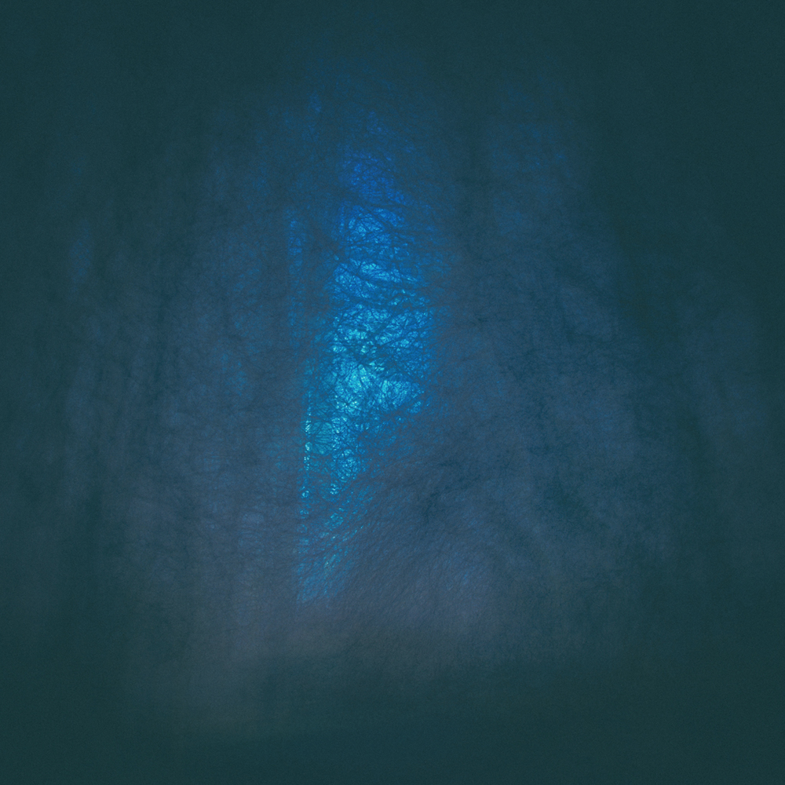
The fading light
Rob Hudson

Slide 33
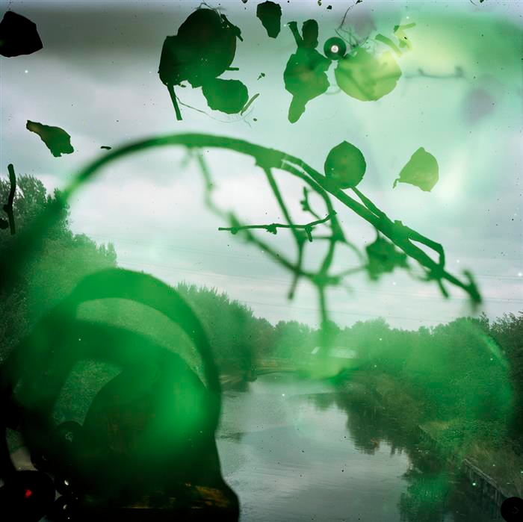
Through and beyond
Steven Gill

